Slide 1
DuraMAT New Project 2-Slide Template
Please complete for your new project. These slides should be incorporated in your future quarterly reporting presentations and updated as needed.

Slide 2
Investigation of Interfacial Degradation in Glass/Glass PV Modules PI: Laura Schelhas - NREL
Chemical/mechanical characterization of G/G module interfaces
Develop adhesion measurements for G/G modules
Demonstrate time-resolved EL imaging method
Core Objective: Fielded Module Forensics
Team: SLAC: Archana Sinha, Sona Ulicna
NREL: Laura Spinella, Steve Johnston, Dana B. Sulas-Kern, Michael Owen-Bellini

Slide 3
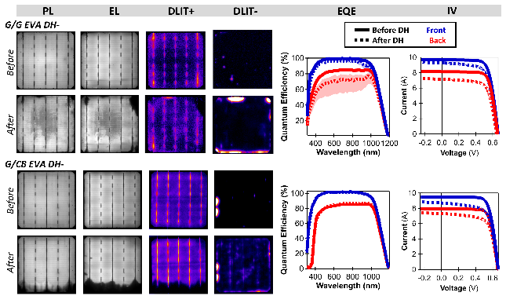
Investigation of Interfacial Degradation in Glass/Glass PV Modules PI: Laura Schelhas - NREL
Here we will provide chemical, structural, and mechanical insights that will enable a cutting-edge understanding of the degradation mechanisms present in glass/glass module interfaces
Collect and generate: G/G panels and MiMos which demonstrate degradation
Imaging techniques: assess the full modules and narrow-in on regions where degradation is occurring
Develop: adhesion measurement methods to confirm and quantify the mechanical degradation.
Characterize: degraded regions will be studied in detail using advanced materials forensics methods to monitor degradation at a fundamental level

